Slide 1

Applied Applied NLP (BUAN 6342) Lecture Gradient Descent
Harpreet Singh
University of Texas at Dallas
Fall 2023

Slide 2
Linear Regression

Slide 3
Linear Regression – 1 output, 1 input
Predicts a quantitative response Y as a function of predictor variable X
Assumes there is approximately a linear relationship between X and Y
Mathematically: ${{Y ≈θ}_{0}+ θ}_{1}X$
Mathematically: 〖〖𝑌 ≈𝜃〗_0+ 𝜃〗_1 𝑋
Parametric model: model coefficients or parameters • $θ_{0}$intercept • $θ_{1}$slope
Parametric model: model coefficients or parameters • 𝜃_0 intercept • 𝜃_1 slope

Slide 4
Linear Regression – 1 output, 1 input
Use training data to produce estimates of model parameters : $θ_{0}$and $θ_{1}$
Use training data to produce estimates of model parameters : 𝜃_0 and 𝜃_1
The prediction $\hat{y }$of $Y$on the basis of $X=x$is: $\hat{y}={{\hat{θ}}_{0}+ \hat{θ}}_{1}x$
The prediction (𝑦 ) ̂of 𝑌 on the basis of 𝑋=𝑥 is: 𝑦 ̂=〖𝜃 ̂_0+ 𝜃 ̂〗_1 𝑥
The hat symbol $^$ means estimated value of an unknown parameter, or the predicted value of the response
The hat symbol ^ means estimated value of an unknown parameter, or the predicted value of the response
We want to choose $θ_{0}$and $θ_{1}$that $\hat{y}$ is as close to all $y$ in $Y$ as possible.
We want to choose 𝜃_0 and 𝜃_1 that 𝑦 ̂ is as close to all 𝑦 in 𝑌 as possible.
Loss Function: Lower value indicated better model performance
J$\left(θ\right)=\sum_{i=1}^{i=8}{{\left({\hat{y}}_{i}−y_{i}\right)}^{2}}$ - Mean Squared error
J(𝜃)=∑_(𝑖=1)^(𝑖=8)▒(𝑦 ̂_𝑖−𝑦_𝑖 )^2 - Mean Squared error

Slide 5











Linear Regression – 1 output, 1 input
$$y$$
$$(x_{8},y_{8})$$
$$(x_{6},y_{6})$$
$$(x_{7},y_{7})$$
$$(x_{4},y_{4})$$
$$(x_{5},y_{5})$$
$$(x_{2},y_{2})$$
$$(x_{3},y_{3})$$
$$(x_{1},y_{1})$$
$$x$$
Model:
$$\hat{y}={θ_{0}+ θ}_{1}x$$

Slide 6

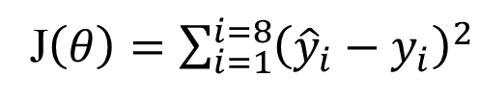
Linear Regression – 1 output, 1 input
$$y$$
$$(x_{8},y_{8})$$
$$(x_{6},y_{6})$$
$$(x_{7},y_{7})$$
$$(x_{4},y_{4})$$
$$(x_{5},y_{5})$$
$$(x_{2},y_{2})$$
$$(x_{3},y_{3})$$
$$(x_{1},y_{1})$$
$$x$$
Model:
$$\hat{y}={{\hat{θ}}_{0}+ \hat{θ}}_{1}x$$
J$\left(θ\right)=\sum_{i=1}^{i=8}{{\left({\hat{y}}_{i}−y_{i}\right)}^{2}}$

Slide 7

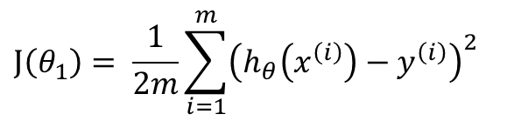
Loss Function
X | Y
1 | 1
2 | 2
3 | 3
$$\hat{y}=h_{θ}\left(x\right)=θ_{0}+θ_{1}x_{1}$$
Let us assume $θ_{0}=0$
$$\hat{y}=h_{θ}\left(x\right)=θ_{1}x_{1}$$
Cost Function:
Goal : Find value of $θ_{1}$ that minimizes $J(θ_{1})$
$$J\left(θ_{1}\right)= \frac{1}{2m}\sum_{i=1}^{m}{{\left(h_{θ}\left(x^{\left(i\right)}\right)−y^{\left(i\right)}\right)}^{2}}$$

Slide 8
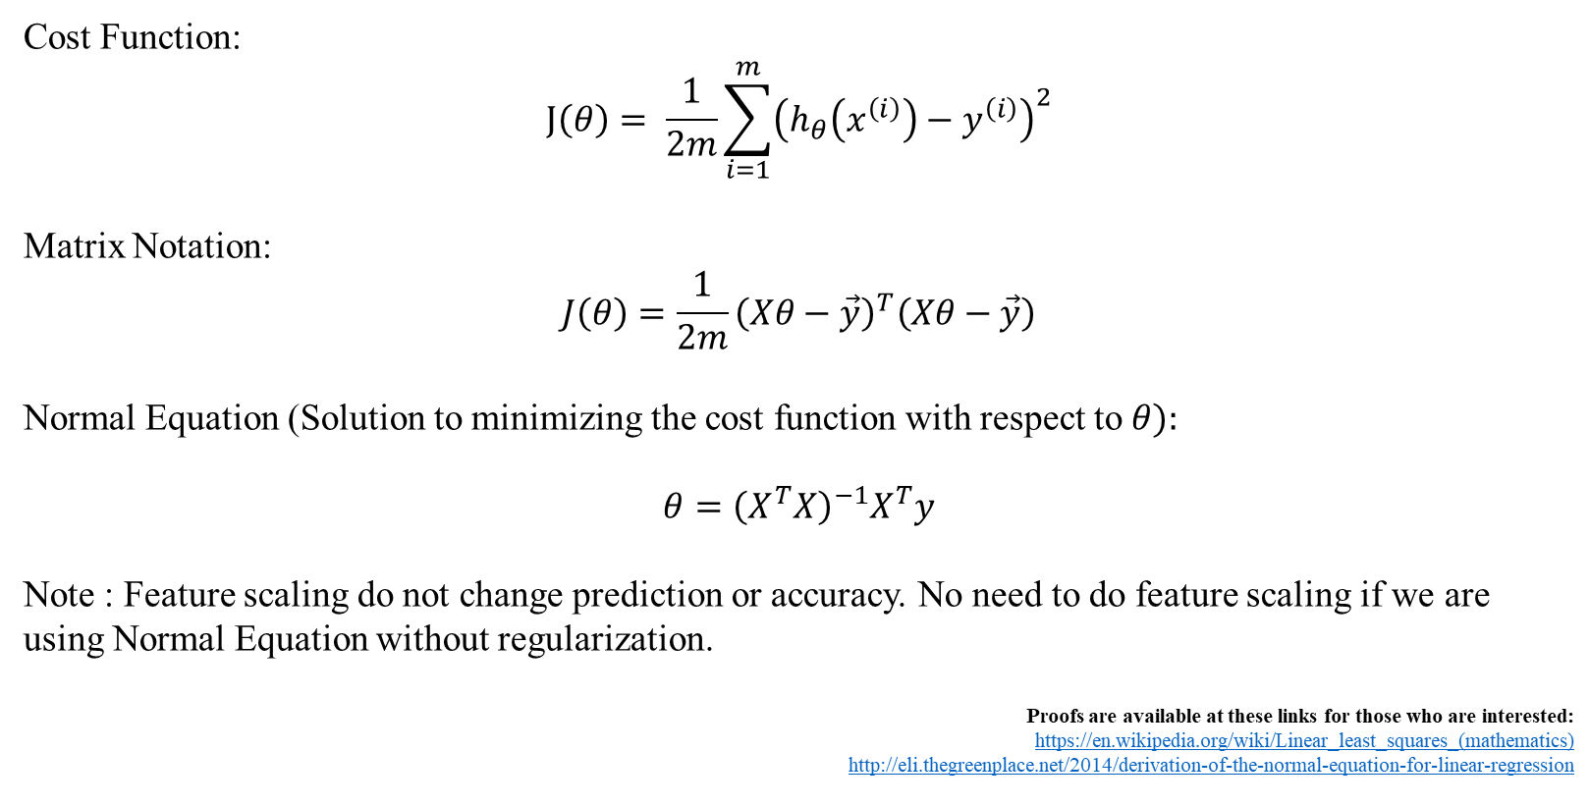
Least Squares Normal Equation
Cost Function:
$$J\left(θ\right)= \frac{1}{2m}\sum_{i=1}^{m}{{\left(h_{θ}\left(x^{\left(i\right)}\right)−y^{\left(i\right)}\right)}^{2}}$$
Matrix Notation:
$$J\left(θ\right)=\frac{1}{2m}{\left(Xθ−\vec{y}\right)}^{T}\left(Xθ−\vec{y}\right)$$
Normal Equation (Solution to minimizing the cost function with respect to $θ):$
$$θ={\left(X^{T}X\right)}^{−1}X^{T}y$$
Note : Feature scaling do not change prediction or accuracy. No need to do feature scaling if we are using Normal Equation without regularization.
Proofs are available at these links for those who are interested:
https://en.wikipedia.org/wiki/Linear_least_squares_(mathematics)
http://eli.thegreenplace.net/2014/derivation-of-the-normal-equation-for-linear-regression
Notes:
Matrix form?

Slide 9
Normal Equation Pros and Cons
Cons:
The computational complexity of linear regression is very high
There is no controlling parameters
Pros:
Prediction is very fast

Slide 10
Gradient Descent

Slide 11

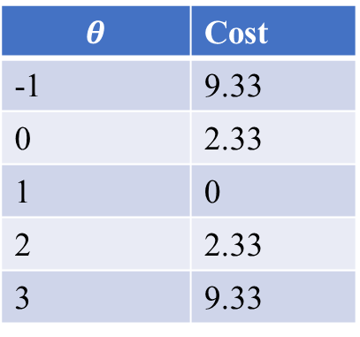
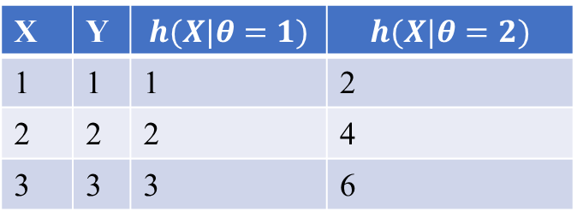

Loss Function
$h_{θ}\left(X\right)$ : For fixed theta this is a function of x
X | Y | $$h(X|θ=1)$$ | $$h(X|θ=2)$$
1 | 1 | 1 | 2
2 | 2 | 2 | 4
3 | 3 | 3 | 6
$J(θ_{1})$ (function of parameter $θ)$
$$θ$$ | Cost
-1 | 9.33
0 | 2.33
1 | 0
2 | 2.33
3 | 9.33
Convex Function

Slide 12

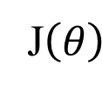

Gradient Descent (GD) (idea)
Start with a random value of $θ$(e.g. $θ=4$)
Start with a random value of 𝜃 (e.g. 𝜃=4)
Compute the gradient (derivative) of $J\left(θ\right)$at point $θ=4$.
Compute the gradient (derivative) of J(𝜃) at point 𝜃=4.
Recompute $θ$ as: $θ=θ−λ∗ gradient$
Recompute 𝜃 as: 𝜃=𝜃−𝜆∗ 𝑔𝑟𝑎𝑑𝑖𝑒𝑛𝑡
J$\left(θ\right)$
$$θ=4$$
$$θ$$

Slide 13
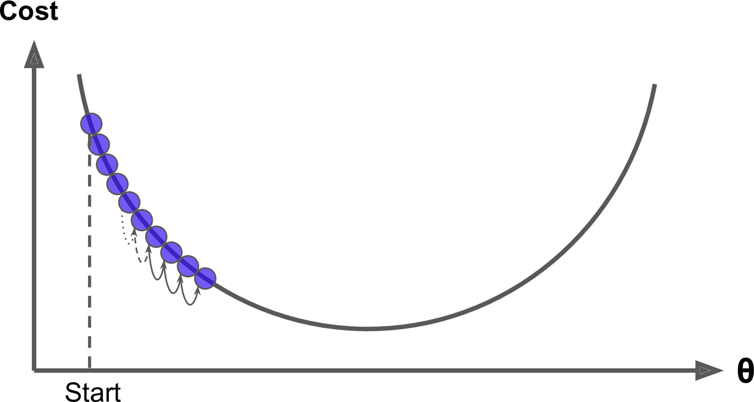
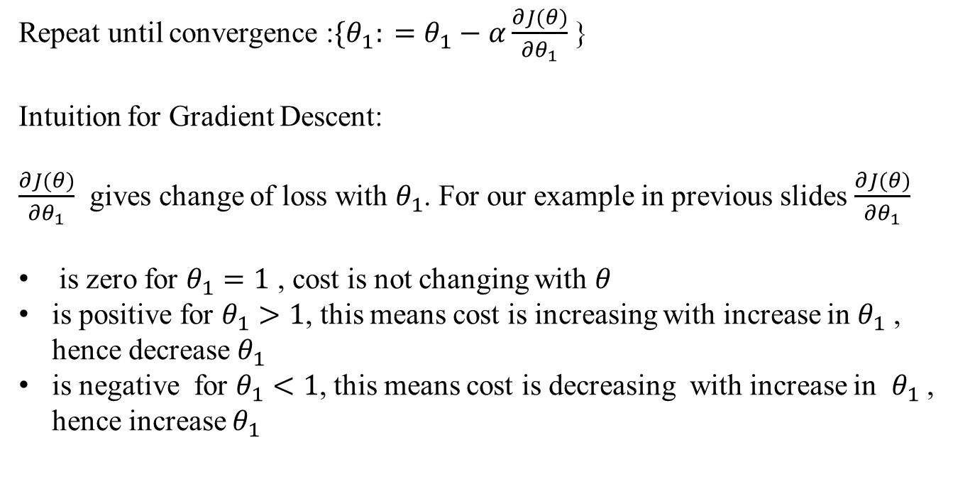
Gradient Descent
Repeat until convergence :${\{θ}_{1}: =θ_{1}−α\frac{∂J(θ)}{∂θ_{1}}$ }
Intuition for Gradient Descent:
$\frac{∂J(θ)}{∂θ_{1}}$ gives change of loss with $θ_{1}$. For our example in previous slides $\frac{∂J(θ)}{∂θ_{1}}$
is zero for $θ_{1}=1$ , cost is not changing with $θ$
is positive for $θ_{1}>1$, this means cost is increasing with increase in $θ_{1}$ , hence decrease $θ_{1}$
is negative for $θ_{1}<1$, this means cost is decreasing with increase in $θ_{1}$ , hence increase $θ_{1}$

Slide 14
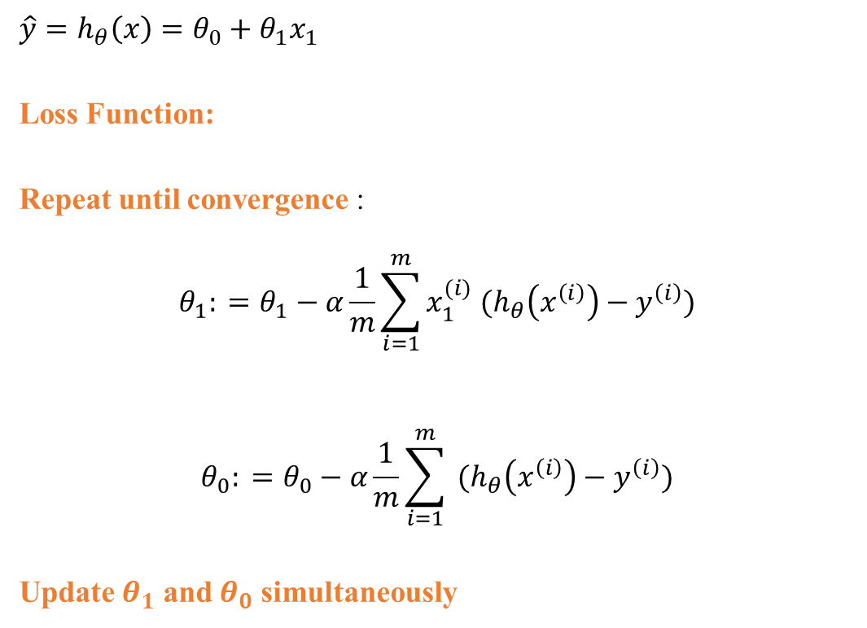
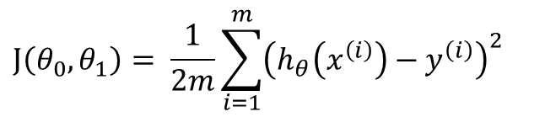
Gradient Descent- Two Parameters
$$\hat{y}=h_{θ}\left(x\right)=θ_{0}+θ_{1}x_{1}$$
Loss Function:
Repeat until convergence :
$$θ_{1}: =θ_{1}−α\frac{1}{m}\sum_{i=1}^{m}{{x_{1}^{(i)} (h}_{θ}\left(x^{\left(i\right)}\right)−y^{\left(i\right)})}$$
$$θ_{0}: =θ_{0}−α\frac{1}{m}\sum_{i=1}^{m}{{ (h}_{θ}\left(x^{\left(i\right)}\right)−y^{\left(i\right)})}$$
Update $θ_{1}$ and $θ_{0}$ simultaneously
$$J\left(θ_{0},θ_{1}\right)= \frac{1}{2m}\sum_{i=1}^{m}{{\left(h_{θ}\left(x^{\left(i\right)}\right)−y^{\left(i\right)}\right)}^{2}}$$
error
error
error

Slide 15
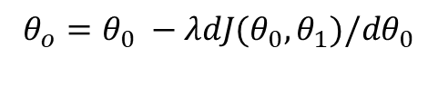


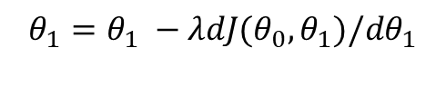



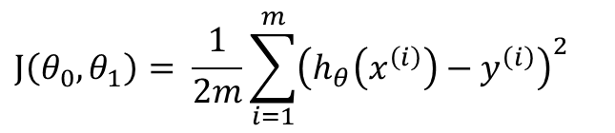


Gradient Descent- Two Parameters
$$λ=0.01$$
$$J\left(θ_{0},θ_{1}\right)= \frac{1}{2m}\sum_{i=1}^{m}{{\left(h_{θ}\left(x^{\left(i\right)}\right)−y^{\left(i\right)}\right)}^{2}}$$
Initialize $θ_{0}$ and $θ_{1}$ randomly
for e = 0, num_epochs do
Compute:
$$dJ(θ_{0},θ_{1})/dθ_{0}$$
and
$$dJ(θ_{0},θ_{1})/dθ_{1}$$
Update $θ_{0}$:
$$θ_{o}=θ_{0} −λdJ(θ_{0},θ_{1})/dθ_{0}$$
Update $θ_{1}$:
$$θ_{1}=θ_{1} −λdJ(θ_{0},θ_{1})/dθ_{1}$$
Print:
J$(θ_{0},θ_{1})$
// Useful to see if this is becoming smaller or not.
end
An epoch is one complete pass through the entire training dataset, during which the model's parameters are updated to minimize the loss of function.
Each Update is based on complete dataset

Slide 16
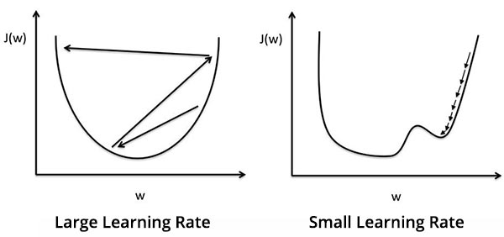
Effect of learning rate

Slide 17
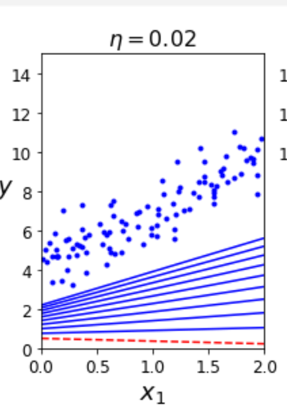
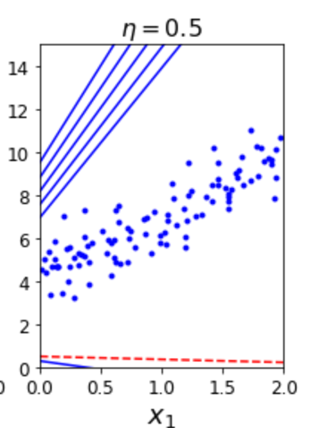
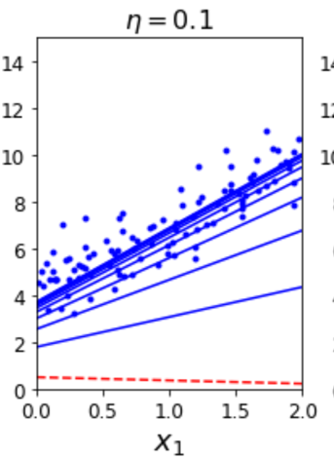
Effect of learning rate - code

Slide 18
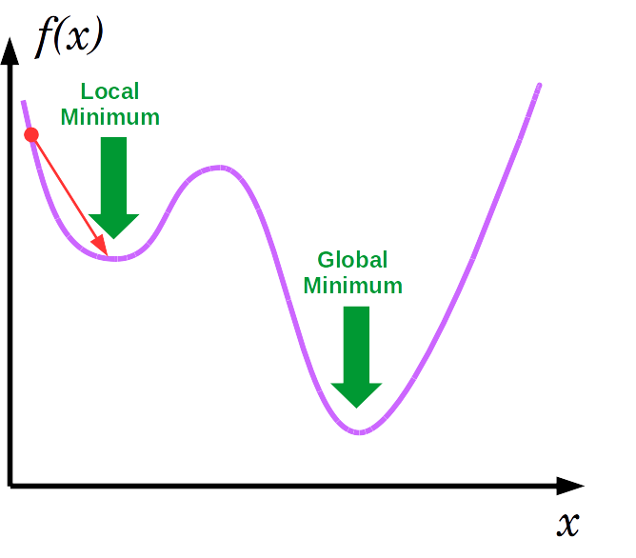
Pros and Cons
Advantages:
Simple and often quite effective on ML tasks
Often very scalable
Drawbacks
Might find a local minimum
Only applies to smooth function (differentiable)
Fortunately, the MSE cost function for a Linear Regression model happens to be a convex function, which means that if you pick any two points on the curve, the line segment joining them never crosses the curve.

Slide 19

Gradient Descent- Two Parameters
expensive
$$λ=0.01$$
$$J\left(θ_{0},θ_{1}\right)= \frac{1}{2m}\sum_{i=1}^{m}{{\left(h_{θ}\left(x^{\left(i\right)}\right)−y^{\left(i\right)}\right)}^{2}}$$
Initialize $θ_{0}$ and $θ_{1}$ randomly
for e = 0, num_epochs do
Compute:
$$dJ(θ_{0},θ_{1})/dθ_{0}$$
and
$$dJ(θ_{0},θ_{1})/dθ_{1}$$
Update $θ_{0}$:
$$θ_{o}=θ_{0} −λdJ(θ_{0},θ_{1})/dθ_{0}$$
Update $θ_{1}$:
$$θ_{1}=θ_{1} −λdJ(θ_{0},θ_{1})/dθ_{1}$$
Print:
$$J(θ_{0},θ_{1})$$
end
An epoch is one complete pass through the entire training dataset, during which the model's parameters are updated to minimize the loss of function.
Each Update is based on complete dataset

Slide 20
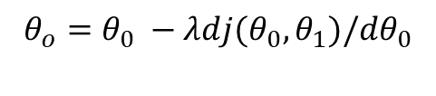

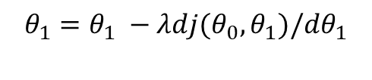


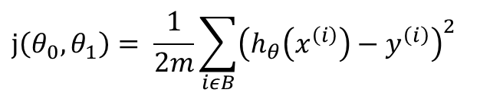


Gradient Descent- Mini Batch
$$λ=0.01$$
Initialize $θ_{0}$ and $θ_{1}$ randomly
$$j\left(θ_{0},θ_{1}\right)= \frac{1}{2m}\sum_{iεB}{{\left(h_{θ}\left(x^{\left(i\right)}\right)−y^{\left(i\right)}\right)}^{2}}$$
for e = 0, num_epochs do
for b = 0, num_batches do
Compute:
$$dj(θ_{0},θ_{1})/dθ_{0}$$
and
$$dj(θ_{0},θ_{1})/dθ_{1}$$
Update $θ_{0}$:
$$θ_{o}=θ_{0} −λdj(θ_{0},θ_{1})/dθ_{0}$$
Update $θ_{1}$:
$$θ_{1}=θ_{1} −λdj(θ_{0},θ_{1})/dθ_{1}$$
Print:
j$(θ_{0},θ_{1})$
// Useful to see if this is becoming smaller or not.
end
An epoch is one complete pass through the entire training dataset, during which the model's parameters are updated to minimize the loss of function.
Each Update is based on a batch of observations

Slide 21
Gradient Descent Variations
Batch Gradient Descent
Mini Batch Gradient Descent
X1 | X2 | Y | Yhat | Error (e) | E * x1 | E * x2
1 update per epoch
All 12 observations will be used in each update of parameters
Let us say Batch size is 3
Gradient is calculated based on 3 observations
In an epoch, we will make 4 updates

Slide 22
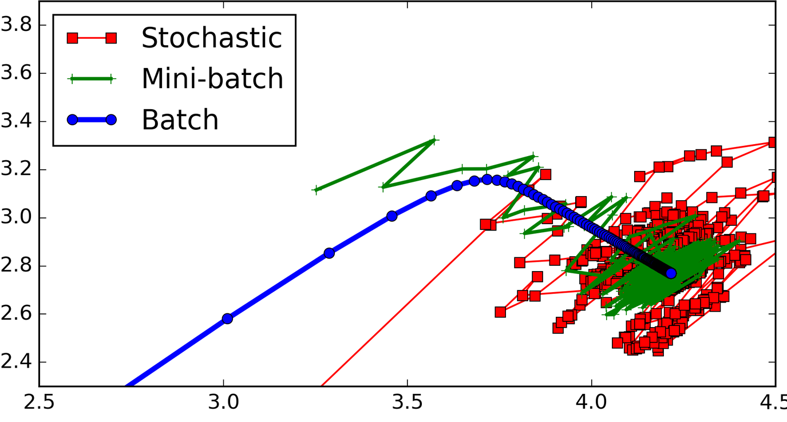
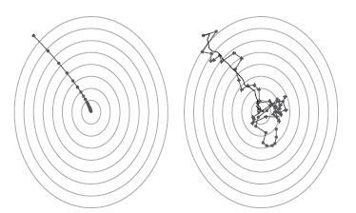
Gradient Descent Variations
Batch Gradient Descent : Uses whole training data at every iteration
Stochastic Gradient Descent: Each step uses a random instance in the training set
Mini Batch Gradient Descent : Each step uses a subset of instance in the training set

Slide 23
Gradient Descent
Direction : Opposite to sign of gradient
Magnitude : Proportional to gradient
Learning rate : Use the learning rate to control the magnitude
Learning rate is hyperparameter, $θ^{′}s$are model parameters
Learning rate is hyperparameter, 𝜃^′ 𝑠 are model parameters
Goal: Adjust weights (model parameters) to improve model

Slide 24

PyTorch Intro
Colab Notebook

